Slide 1
UI – HTML/CSS/BS

Slide 2
HTML documents
HTML (HyperText Markup Language) documents are the core of the web, used to structure and present content on the internet.
It has the following:
Document Declaration :<!DOCTYPE html>
HTML Root Element : <html></html>
Head Section : <head>....</head>

Slide 3
Using doctype
What is DOCTYPE : <!DOCTYPE html> tells the browser that the page is written using the HTML5 standard, which helps it render the page correctly.

Slide 4
The head element
The <head> element in HTML is a container for metadata (data about the HTML document) and links to external resources. It is placed at the beginning of an HTML document, before the <body> element. The content inside the <head> is not directly displayed on the webpage but is essential for the functionality, appearance, and search engine optimization (SEO) of the page.

Slide 5
Using <head>
The <head> element in HTML is a container for metadata and links to external resources. It is placed within the <html> document structure, immediately after the opening <html> tag and before the <body> tag.
Purpose of the <head> Element :
The <head> element provides information about the document that doesn't appear directly on the webpage. It includes metadata, styles, scripts, and other resources required for the webpage.
Common Elements Inside <head>
<title>, <meta>, <link>, <style>, <script>, <base>

Slide 6
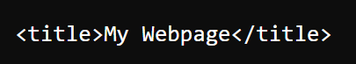
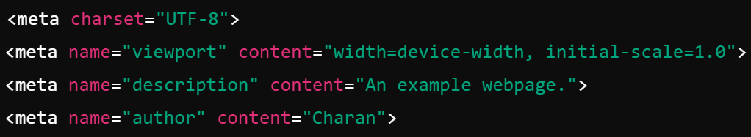
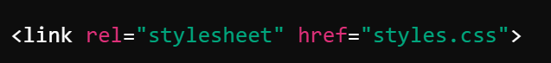
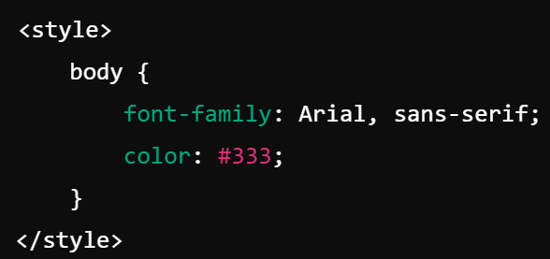
Using <head>
<title> --> Specifies the title of the html plage
<meta> --> Provides the meta information.
Link : Provides external stylesheet reference.
<style> --> Providesthe style fo the html

Slide 7
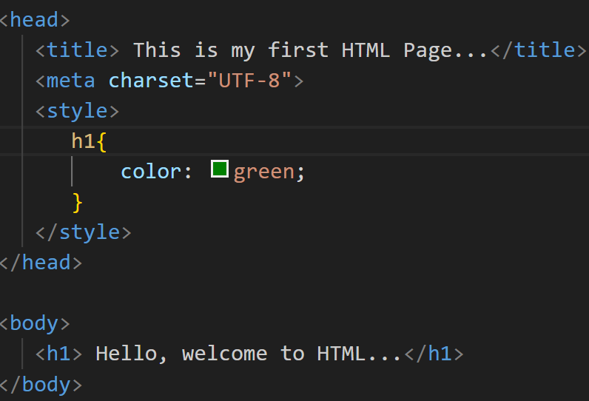
Using <head>

Slide 8
The body element
The <body> element in HTML represents the content of the document that is visible to the user in the web browser. It is one of the core elements in an HTML document and is used to define everything that should appear as part of the webpage, such as text, images, videos, forms, links, and other interactive elements.

Slide 9
Using id and class attributes
The id and class attributes in HTML are used to define and target elements for styling, scripting, or other purposes.

Slide 10
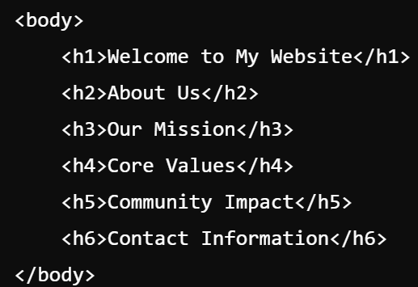
HTML Text - Headings
HTML headings are essential elements used to structure and organize the content of a webpage. They range from <h1> to <h6>, where <h1> is the highest level (most important) heading, and <h6> is the lowest level (least important).

Slide 11
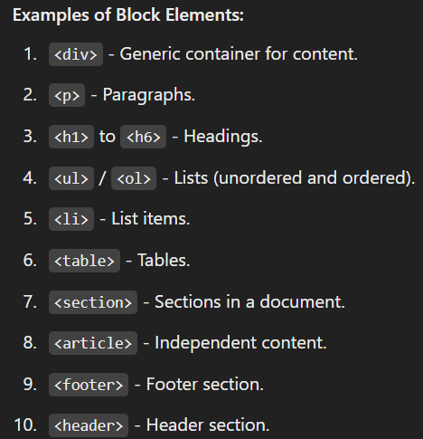
HTML Text - Block and Inline Elements
In HTML, elements are categorized into block elements and inline elements based on their behavior and rendering on the web page.
Block Elements : Block elements take up the full width of their container and always start on a new line.
Features: Creates a block-level box. Can contain other block elements or inline elements. Useful for structuring the layout of the webpage.

Slide 12
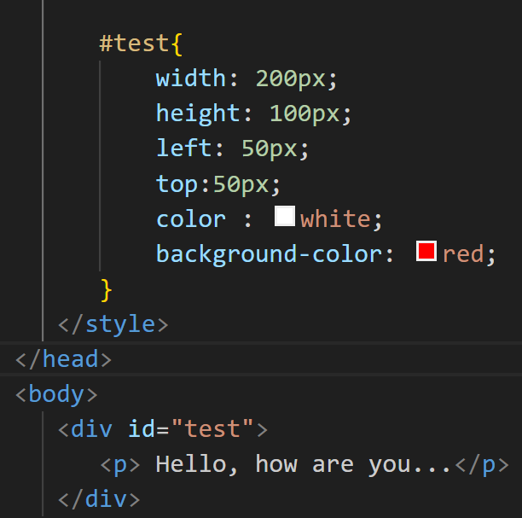
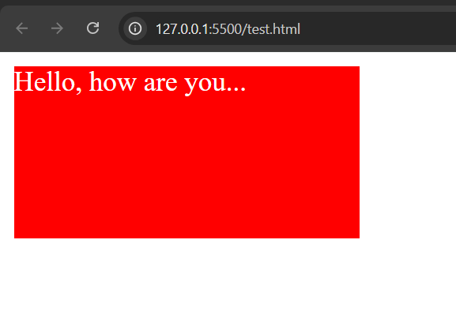
HTML Text - Block and Inline Elements
Div bloc :

Slide 13
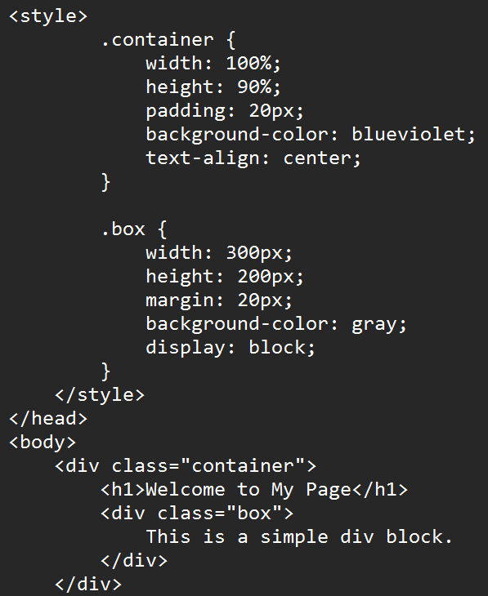
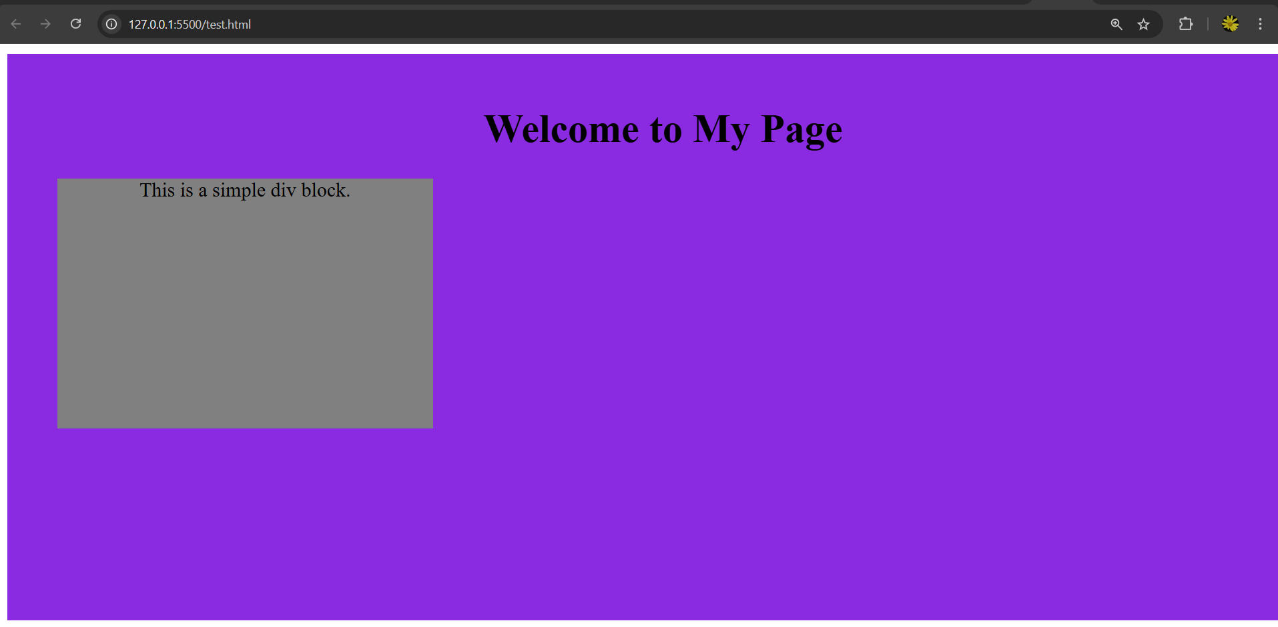
HTML Text - Block and Inline Elements
Another Div block example :

Slide 14
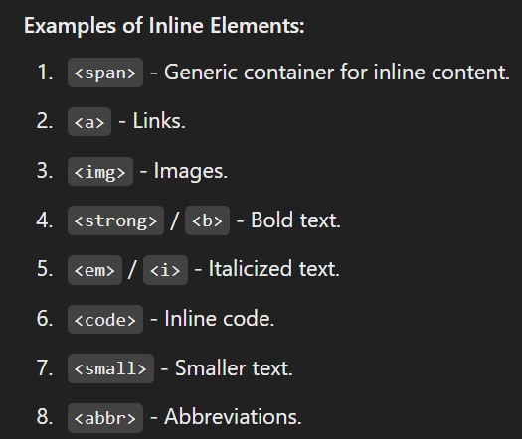
HTML Text - Block and Inline Elements
Inline Elements : Inline elements only take up as much width as necessary and do not start on a new line.

Slide 15
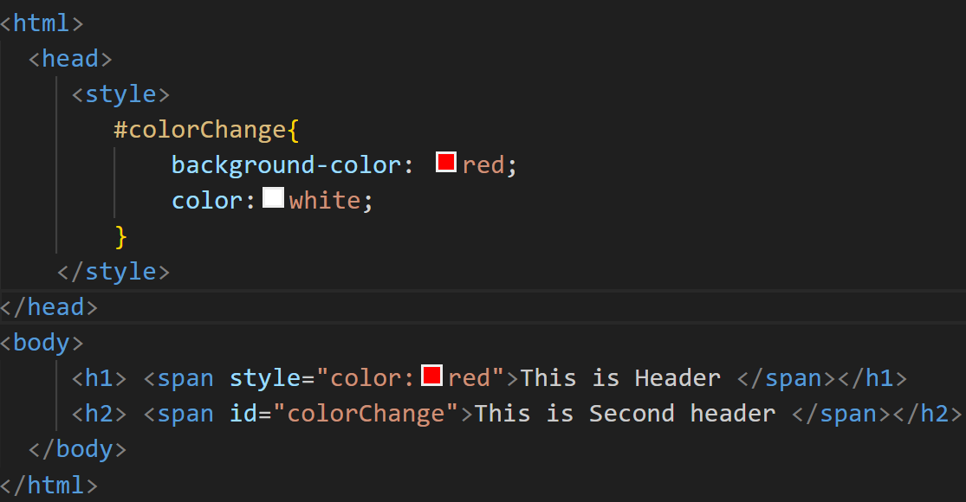
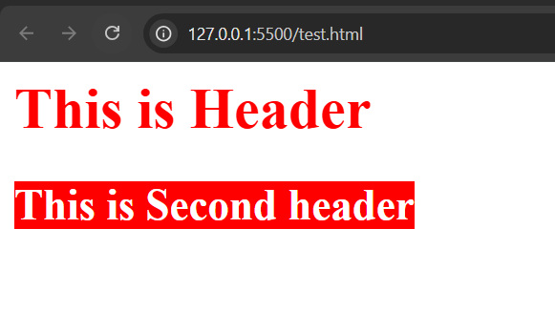
HTML Text - Block and Inline Elements
<span> -- The <span> element in HTML is an inline container used to group or style text or inline elements. It does not inherently affect the layout or presentation of the document unless styled with CSS.

Slide 16
HTML Lists - List Types
There are two types of lists.. They are
Ordered List
Unordered List.
Definition List.

Slide 17
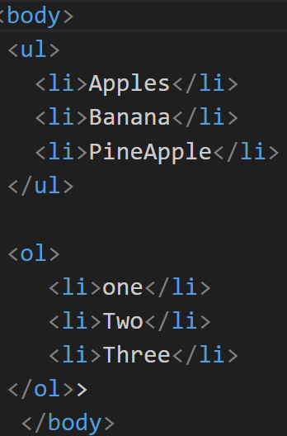
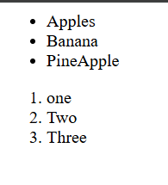
Creating Lists
Creating ordered and
unordered list.

Slide 18
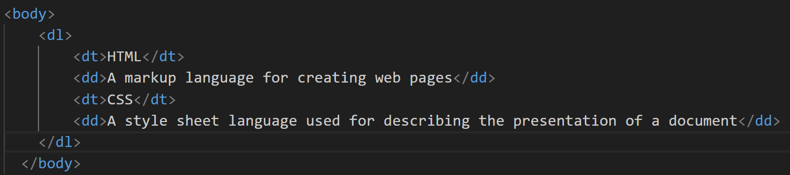
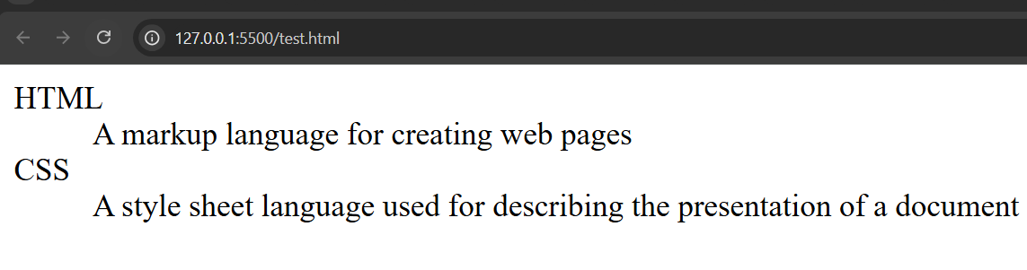
List Rendering
Previous example can used for UL and OL.

Slide 19
HTML Links - Link concepts.
HTML Links
HTML links are created using the <a> (anchor) element, which is used to define hyperlinks that allow users to navigate between different pages or sections within a page or external sites.
Link Concepts : A link in HTML is typically created with the <a> element, which stands for "anchor". The anchor element allows you to link to other web pages, files, or specific parts of a page. The href attribute in the <a> tag specifies the destination of the link.

Slide 20
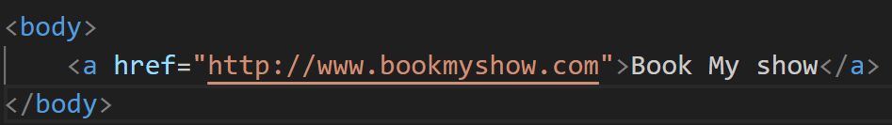
Linking Documents
Linking Documents
You can link to external documents or pages (like HTML files, PDF documents, or other resources) by providing the appropriate URL in the href attribute.

Slide 21
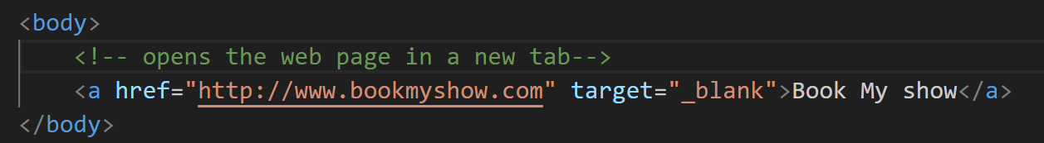
Understanding Targets
he target attribute in the <a> tag is used to specify where the linked document will open when the link is clicked. By default, links open in the same window or tab, but you can control this behavior with different values for the target attribute.

Slide 22
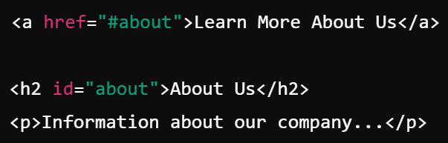
Linking to Targets
Linking to Targets
You can link to specific sections or elements within the same document or other documents. This is typically done using anchor links, which reference an element with a specific id attribute.

Slide 23
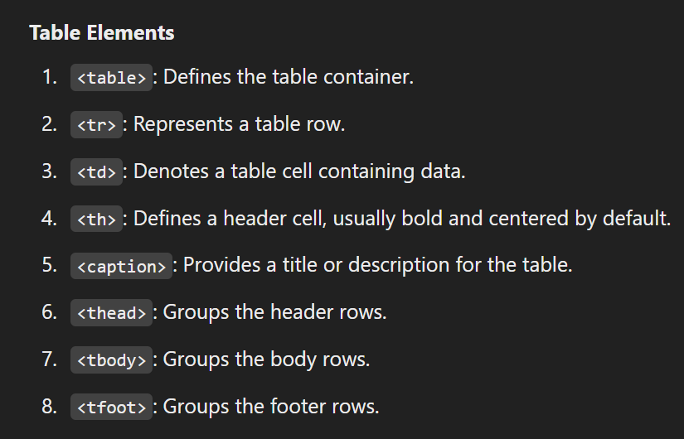
HTML Tables -Table Elements
HTML Tables : HTML tables are used to organize and display data in a tabular format consisting of rows and columns.

Slide 24
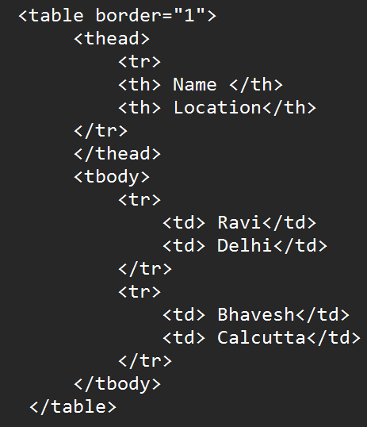
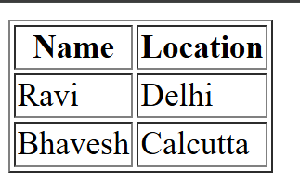
Structuring a Table
A well-structured table typically includes:
Table headers (<th>) for column or row titles.
A table body (<tbody>) for main data rows.
Optional header (<thead>)

Slide 25
Table Data
Table Data
Cell content: Insert text, images, or even other HTML elements inside <td> or <th>.
Alignment: Adjust alignment using text-align and vertical-align properties in CSS.

Slide 26
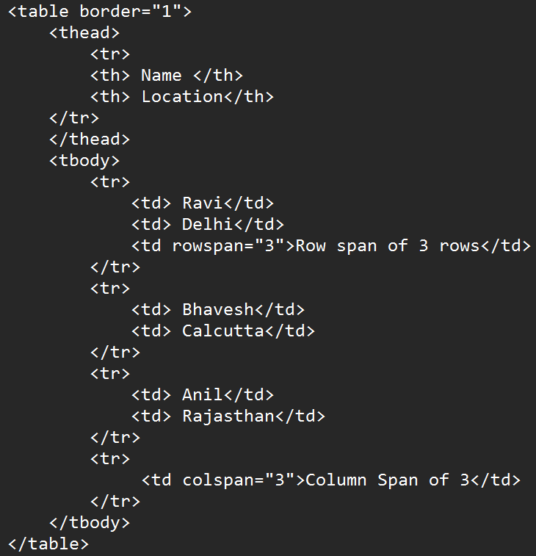
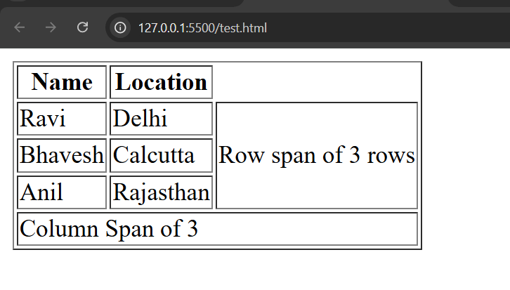
Spanning Columns and Rows

Slide 27
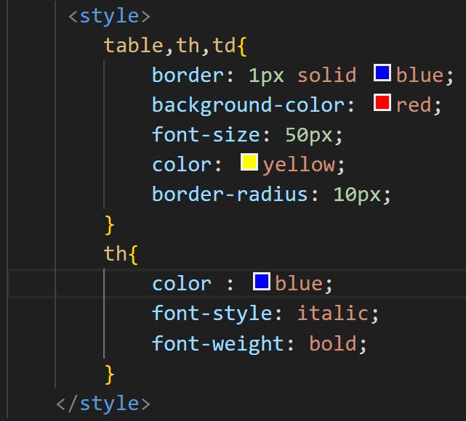
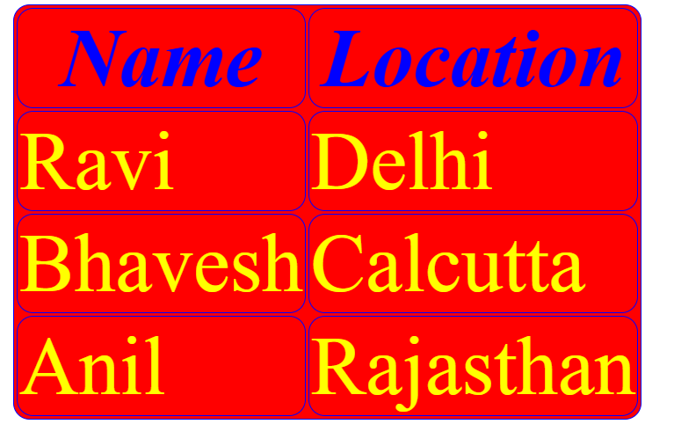
Formatting Tables
Adding styles for the table will give the following output

Slide 28
HTML Images and Objects - Image and Object Concepts
Image and Object Concepts
Images (<img>):
Used to display pictures, icons, or other raster/vector graphics.
Supports formats like JPG, PNG, GIF, SVG, and WEBP.
Lightweight and essential for visual enhancement of web pages.
Objects (<object>):
Used to embed multimedia content (e.g., PDFs, videos, or applets) or interactive content.
Provides fallback content if the object cannot be rendered.

Slide 29
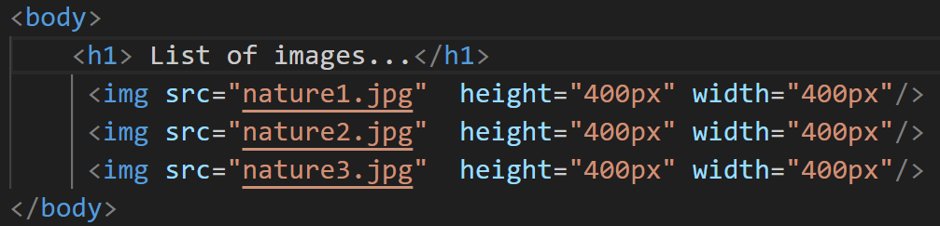

Adding Images

Slide 30
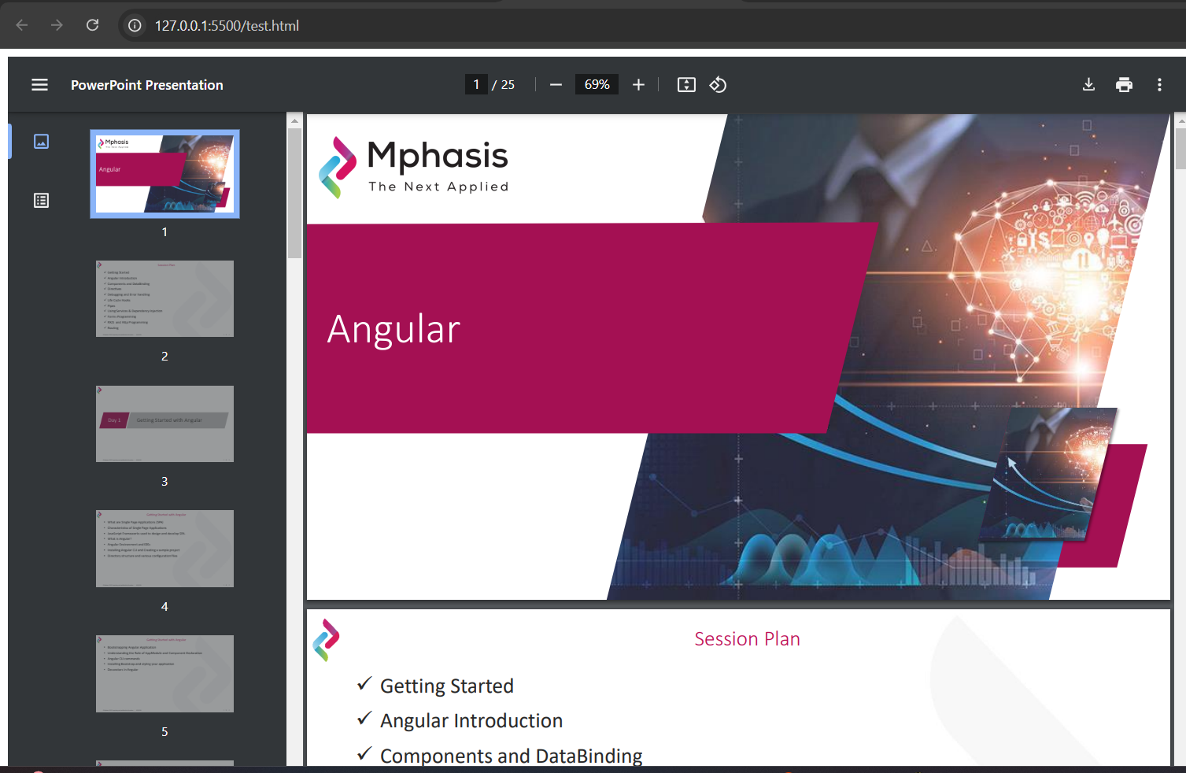
Adding Objects

Slide 31
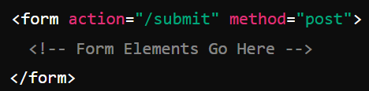
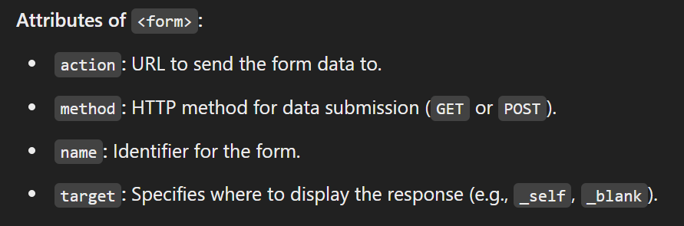
HTML Forms - HTML forms fundamentals
HTML forms are used to collect user input and send it to a server for processing. They are essential for creating interactive web applications like login pages, surveys, and registration forms.

Slide 32
Form Basics
Commonly used form controls:
Text Input
Password Input
Checkbox
Radiobutton
Dropdown
Text Area
Submit Button.

Slide 33
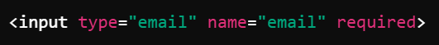
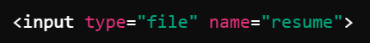
Form Settings
Following can be given in the form as setting.
Required :
File uploads :
Hidden Inputs :
Place Holders :
Reset form :

Slide 34
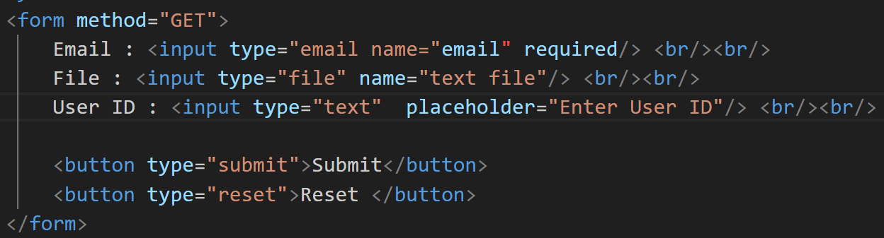
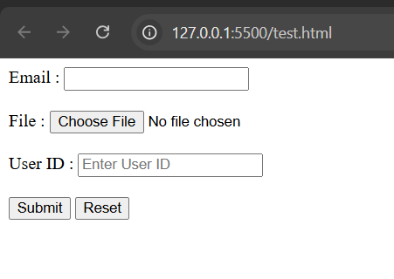
Form Settings

Slide 35
HTML form input - Text inputs
HTML form inputs provide a way for users to interact with a webpage and submit data.
Single Line Input :
Password :
Email :
Number :

Slide 36
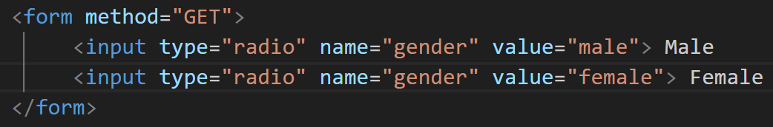
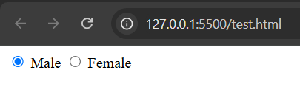
Selections
The selections are (a) Radiobutton (b) Checkbox (c) Drowndown and (d) Multi Select Dropdown.
Radiobutton

Slide 37
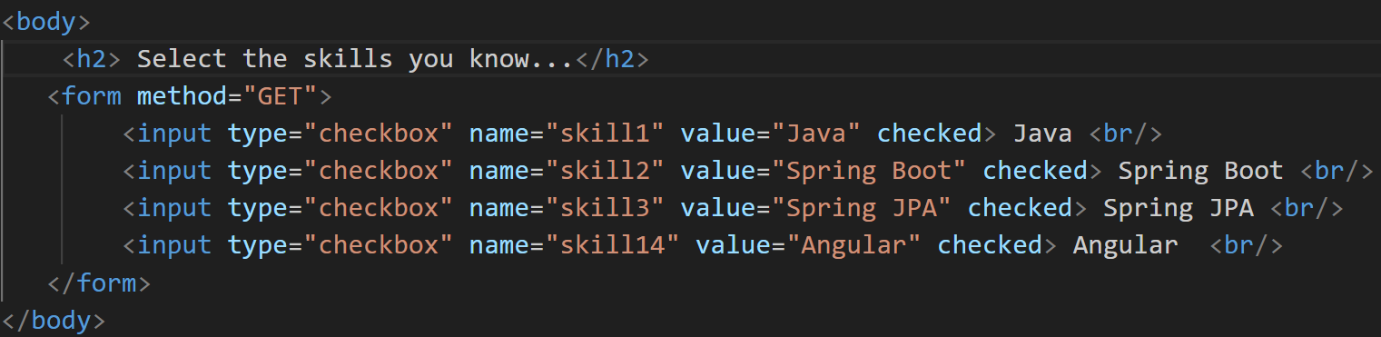
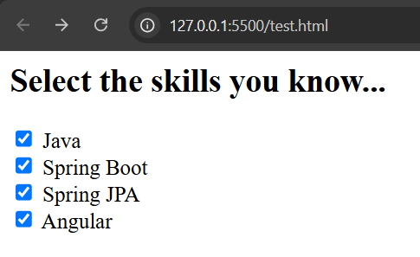
Selections
Checkbox

Slide 38
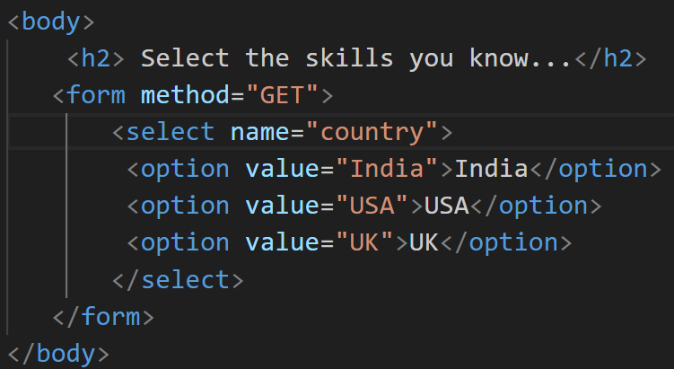
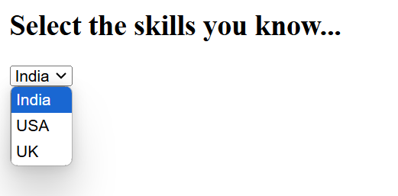
Selections
Choice :

Slide 39
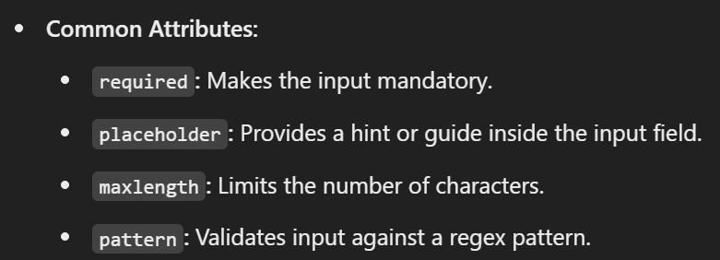
Input attributes.

Slide 40
Input commands.
Submit button
Reset Button
File uploads
Hidden data.

Slide 41
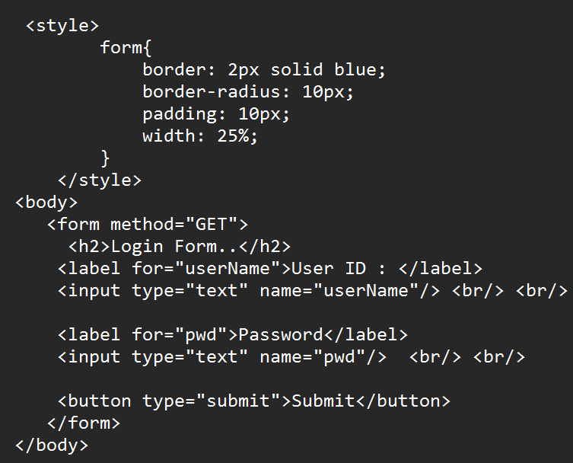
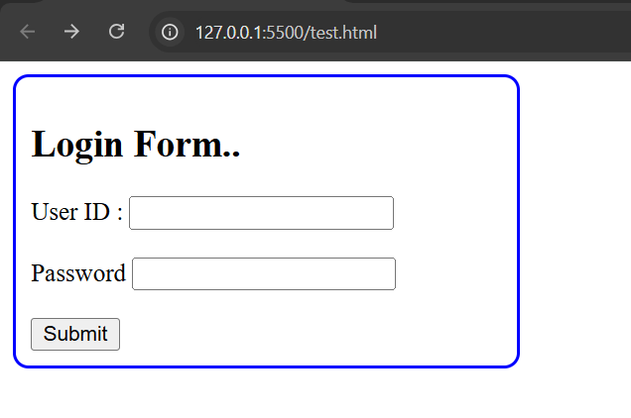
Labels
Used to associate descriptive text with form inputs.

Slide 42
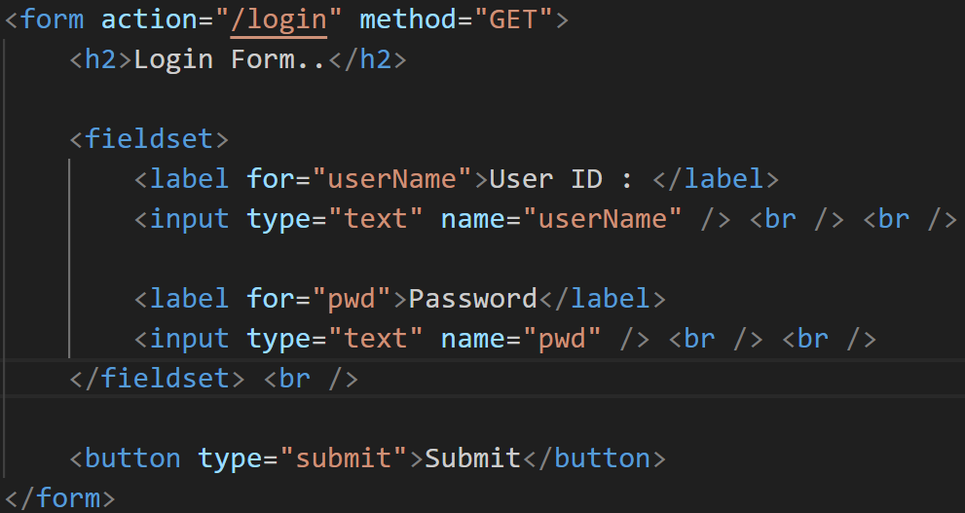
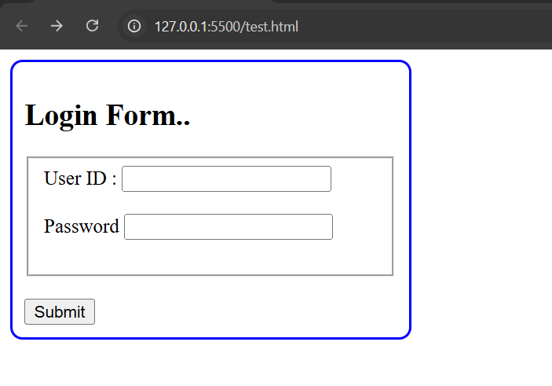
Fieldsets
FieldSet groups the elements :

Slide 43
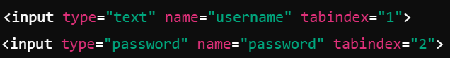
Tab index
Controls the navigation order of inputs using the Tab key.

Slide 44
Access keys
Assigns a keyboard shortcut to activate a form element. Submit button also can be invoked by Alt+ s.

Slide 45
HTML form scenarios -Scripting forms
JavaScript is often used to validate form inputs, manipulate form elements, and handle form submission dynamically.

Slide 46
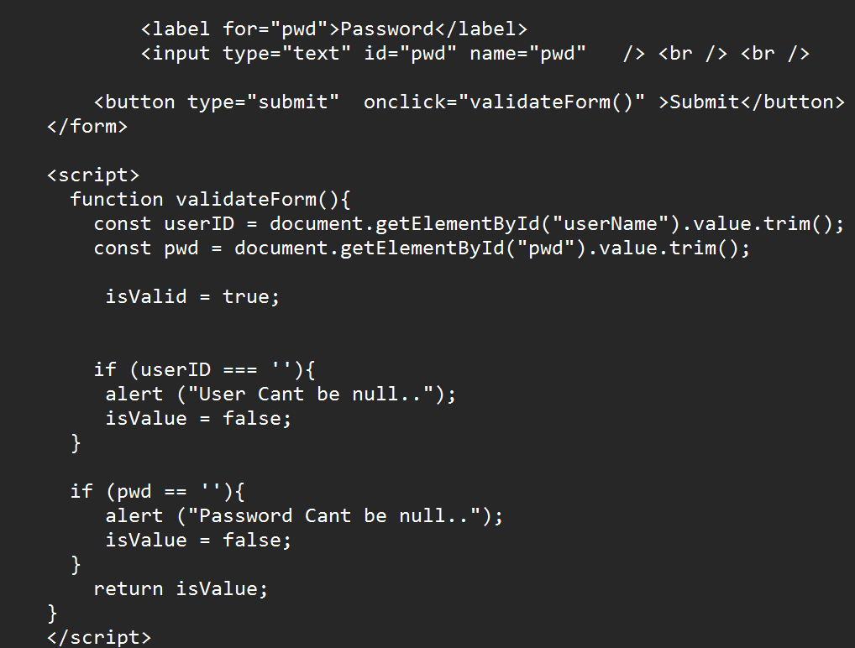
HTML form scenarios -Scripting forms

Slide 47
Handling multiple forms
Handling multiple forms in HTML involves assigning unique identifiers or names to each form and managing them independently in JavaScript. This allows you to perform distinct actions for each form, such as validation or submission.

Slide 48
What’s new in HTML5 - What is HTML5?
What’s New in HTML5 : HTML5 is a major revision of the HTML standard, introducing new elements, attributes, and APIs to support modern web development. It focuses on improving the structure, multimedia capabilities, and interactivity of web pages while enhancing browser performance and compatibility.
What is HTML5 : HTML5 is the fifth version of the HyperText Markup Language (HTML) used for structuring and presenting content on the web. Key goals include:
Enhanced support for multimedia (audio, video).
Improved semantics and document structure.
Greater interactivity via new APIs.
Better cross-platform compatibility (e.g., mobile).

Slide 49
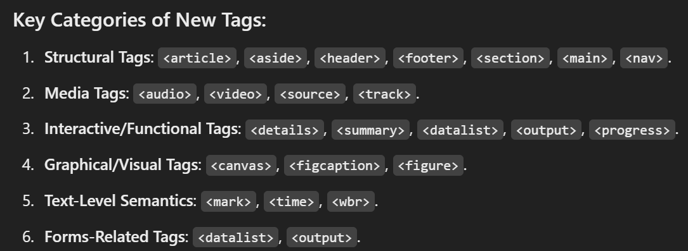
New HTML5 Elements

Slide 50



Slide 51



Slide 52

New JavaScript APIs

Slide 53
When is HTML5 Fully Compliant with All Browsers?
HTML5 is supported by most modern browsers like Chrome, Firefox, Edge, Safari, and Opera. However, older versions of Internet Explorer (like IE8) do not support many HTML5 features. Compatibility can vary, but using polyfills (e.g., Modernizr) can bridge the gap for unsupported features.

Slide 54


Markup Example Before and After HTML5
Before HTML5 After HTML5

Slide 55


Detecting HTML5 Features

Slide 56

Semantic HTML - What Is Semantic HTML?
What Is Semantic HTML? : Semantic HTML introduces elements that describe their purpose in the context of a document, making the content more understandable for: Browsers, Search engines, Assistive technologies (e.g., screen readers)
Benefits of Semantic HTML: Accessibility: Screen readers can better interpret the page structure. SEO: Search engines prioritize meaningful content. Maintainability: Easier for developers to understand and update code.

Slide 57
Auditing a Site for Semantic Issues
Auditing a website involves identifying non-semantic elements, improper usage of semantic tags, and opportunities to improve accessibility and SEO.
Steps to Audit for Semantic Issues:
Examine the Document Outline: Ensure proper use of heading tags (<h1> to <h6>).
Check for Proper Tag Usage:
Validate Navigation:
Verify Form Elements:
Media and Images:
Accessibility and ARIA Roles:
Check the Main Content:
Validate Using Tools:

Slide 58
HTML Outlines -Outlines in HTML4 vs. HTML5
HTML Outlines : The HTML document outline defines the hierarchy and structure of a web page. It helps browsers, screen readers, and search engines understand how content is organized, making it critical for accessibility and SEO.
Outlines in HTML4 : Relies on proper use of heading tags (<h1> to <h6>) to create a structure.
Outlines in HTML5 : Introduces sectioning elements that improve document structure and hierarchy: <article>, <section>, <nav>, <aside>, <header>, <footer>, <main>.

Slide 59

Text-level Semantic Elements
Text-Level Semantic Elements
HTML5 introduces text-level semantic elements that provide more meaning to inline content. These tags help search engines and assistive technologies understand the purpose of the text.

Slide 60



Semantic Forms
HTML5 significantly enhances forms with new semantic elements, attributes, and types, improving user experience and accessibility.
New Form Elements New Input Types
Attributes for Improved Semantics

Slide 61


Forms - New Input Types?
Forms in HTML5 : HTML5 enhances forms with new input types, attributes, and validation features, making them more user-friendly and reducing the need for JavaScript for basic validation.
New in
HTML5

Slide 62

Forms - New Input Types?

Slide 63

New Input Types: Markup Review

Slide 64

New Input Types: In Different Browsers to Native Validation

Slide 65


Using the Datalist Tag

Slide 66

Working with Pseudo Classes

Slide 67


Exposing Custom Validation Messages
HTML5 allows developers to create custom validation messages to enhance user experience by providing meaningful error messages. HTML

Slide 68

Native Validation Rules

Slide 69

Custom Validation Rules

Slide 70


HTML5 Design - XHTML vs. HTML5
XHTML (Extensible Hypertext Markup Language) is a web markup language designed to extend and improve upon HTML by combining it with the stricter rules of XML (Extensible Markup Language). It provides a more rigorous and structured approach to defining web pages compared to traditional HTML.
HTML XHTML

Slide 71

HTML5 Design - XHTML vs. HTML5

Slide 72



Building with HTML5

Slide 73
HTML5 Audio & Video
Audio and video is demonstrated in the previous session.

Slide 74
HTML5 Video Captions
HTML5 Video Captions : HTML5 supports adding captions or subtitles to videos using the <track> element. This is useful for accessibility, allowing viewers to understand video content even if they are hearing-impaired or do not understand the spoken language.

Slide 75

CSS - Styling With CSS -Overview of CSS
Styling with CSS: Overview and Techniques : CSS (Cascading Style Sheets) is used to style HTML content, enabling developers to control the layout, colors, fonts, and overall design of web pages.
Overview of CSS : What is CSS? : CSS describes how HTML elements should be displayed on the screen or in other media.
Types of CSS:
Inline CSS: Applied directly to HTML elements using the style attribute.
Example: <p style="color: blue;">Hello World</p>
Internal CSS: Written within a <style> tag in the <head> of an HTML document.

Slide 76



CSS - Styling With CSS -Overview of CSS
External CSS: Written in a separate .css file and linked to the HTML using a <link> tag.
Example:

Slide 77

Adding CSS and How

Slide 78

Fonts

Slide 79
Colors
Color and background-color can be used to set the color and background color.

Slide 80


Shadowing

Slide 81
Rounded Corners
Border-radius is used for rounded corners.

Slide 82


Gradients

Slide 83
Transforms
Transform is used in css for transformation. Couple of options are there
1. Translate (x,y) --> Moves the images by so many pixels.
2. rotate (xdeg, y deg) --> Rotates xdeg and y deg.
3. skew(xdeg, ydeg)
4. scale (5,5) --> scales by 5 in x and 5 in y.

Slide 84


Transforms

Slide 85


Form Inputs

Slide 86

Form Inputs

Slide 87
Bootstrap - History of Bootstrap -- Need for Bootstrap
History of Bootstrap : Bootstrap, originally named "Twitter Blueprint," was developed by Mark Otto and Jacob Thornton at Twitter in 2010. It was open-sourced in 2011 to help developers build responsive and mobile-first websites quickly. Bootstrap has since become one of the most popular front-end frameworks.
Need for Bootstrap :
Responsive Design: Simplifies creating layouts that adapt to different screen sizes. Consistency: Ensures uniformity in design across devices and browsers.
Ease of Use: Prebuilt CSS classes and JavaScript components accelerate development.
Customizability: Allows developers to use only the needed components, reducing overhead.
Community Support: Large community and extensive documentation.

Slide 88

Technologies and Features of Bootstrap

Slide 89
Bootstrap Requirements
Bootstrap Requirements
Modern Browser Support: Compatible with modern browsers like Chrome, Firefox, and Safari.
HTML5 and CSS3: Utilizes modern web technologies for rendering.
jQuery (Up to v4): Older Bootstrap versions depend on jQuery, though newer versions do not.
Knowledge of CSS and HTML: Basic understanding is necessary to use Bootstrap effectively.

Slide 90


Build a Template for Bootstrap Use

Slide 91
Bootstrap Containers
Types of Containers:
.container: Fixed-width container that adapts to the screen size.
.container-fluid: Full-width container spanning the entire viewport

Slide 92
Bootstrap Grid System
Bootstrap Grid System
12-column layout: Divide the screen into 12 columns for flexible layouts.
Responsive breakpoints: Customize grid behavior at different screen sizes (sm, md, lg, xl, xxl).
Classes: Use .row and .col to create rows and columns.

Slide 93


Bootstrap Typography
Bootstrap provides powerful typography styles to make web content visually appealing and well-structured.

Slide 94


Bootstrap Tables

Slide 95


Bootstrap Form

Slide 96

Bootstrap Inputs

Slide 97

Bootstrap Inputs

Slide 98


Bootstrap Inputs Group
Bootstrap input groups are a powerful feature that allows you to enhance input fields with additional elements like text, buttons, dropdowns, or icons. Input groups are often used to provide context or actions related to the input field, improving usability and user experience. @ and text box is combined. Next line edit box and button is combined using input-group.

Slide 99
Bootstrap List Groups
Bootstrap List Groups : Bootstrap List Groups are flexible and powerful components for displaying lists of items in a structured and visually appealing manner. They can be used to show text, badges, links, or custom content.

Slide 100


Bootstrap List Groups

Slide 101

Form State and Buttons

Slide 102


Form State and Buttons
Buttons :

Slide 103

Form State and Buttons

Slide 104


Bootstrap Button Groups

Slide 105


Bootstrap Images and Utilities

Slide 106
Bootstrap Utilities
Text Utilities
Text Alignment: text-{start|center|end}
Text Transform: text-{lowercase|uppercase|capitalize}
Background Utilities
Background color: bg-{color} (e.g., bg-primary, bg-light)
Borders
Border: border, border-{side}-{color}
Border Radius: rounded, rounded-{side|pill|circle}

Slide 107

Utilities for Positioning and Responsiveness

Slide 108


Utilities for Positioning and Responsiveness

Slide 109

Utilities for Positioning and Responsiveness

Slide 110

Navigation by Tabs, Pills and with Dropdown

Slide 111

Navigation by Tabs, Pills and with Dropdown

Slide 112


Navbar

Slide 113


Breadcrumbs

Slide 114


Pagination

Slide 115

Carousel

Slide 116



Carousel

Slide 117


Toast

Slide 118


Panels
When we have to quote some content on a webpage, we can use a panel. We place the content inbox with some padding around it. A bootstrap panel is indicated with a “panel” class. In bootstrap 4 and 5 onwards, Cards are used for this.

Slide 119


Labels
In Bootstrap, labels were traditionally used in earlier versions (Bootstrap 3) for tagging elements with badges-like styling. However, in Bootstrap 4 and 5, the label component was removed, and the badge component is now used instead.

Slide 120
What are Single Page Applications (SPA)
Single Page Applications (SPA) : A Single Page Application (SPA) is a web application that dynamically updates the content of a single web page instead of loading separate pages from the server. This enhances performance and provides a seamless user experience similar to desktop applications.

Slide 121
Characteristics of Single Page Applications
Characteristics of Single Page Applications
Fast Performance – Since only data is loaded (not entire pages), SPAs are faster than traditional multi-page applications.
Client-Side Rendering (CSR) – Most of the UI updates happen on the client side using JavaScript.
Asynchronous Data Loading – Uses AJAX or Fetch API to communicate with the server and fetch data without reloading the page.
Smooth User Experience – SPAs provide a fluid and interactive experience without the need for full-page refreshes.
Modular Development – SPAs are often built with reusable components, making development and maintenance easier.
Back-End as API – The backend primarily serves as a RESTful API that communicates with the front-end.
Uses Routing Mechanisms – SPAs use JavaScript-based routing (e.g., Angular Router) to navigate between views.

Slide 122
JavaScript Frameworks used to design and develop SPA.
Several JavaScript frameworks and libraries help in developing SPAs, including:
Angular (Google)
React.js (Meta/Facebook)
Vue.js (Community-driven)
Ember.js
Svelte

Slide 123
What is Angular?
Angular is a TypeScript-based open-source framework developed by Google for building dynamic and scalable web applications. It is widely used for developing Single Page Applications (SPA) and provides:
A component-based architecture
Dependency Injection
Two-way data binding
Directives and templates
Modular development with Angular modules

Slide 124
Angular Environment and IDEs
IDEs for Angular Development:
Visual Studio Code (Most popular, with extensions for Angular)
WebStorm (Powerful but paid)
IntelliJ IDEA (Supports Angular with plugins)
Sublime Text (Lightweight but requires additional setup)

Slide 125
Installing Angular CLI and Creating a sample project
To install Angular
Node -v
Npm -v
Npm install -g @angular/cli
Ng version
ng new my-app –no-standalone
Press enter for CSS and No for SSR.
Cd myapp
Ng serve –open --> This will open Angular in browser.

Slide 126

Directory structure and various configuration files

Slide 127
Bootstrapping Angular Application
Bootstrapping in Angular refers to the process of initializing and launching an Angular application. This involves defining the root module (AppModule) and the root component (AppComponent), which will be rendered in the index.html file.

Slide 128
Understanding the Role of AppModule and Component Declaration
The AppModule is the main module where all components, directives, and services are registered.
Each Angular component consists of:
@Component decorator defining metadata.
HTML template (app.component.html).
CSS styles (app.component.css)

Slide 129

Angular CLI commands

Slide 130

Angular CLI commands

Slide 131

Installing Bootstrap and styling your application
Npm install bootstrap in the directory of the angular project.
Open angular.json and add this text there add it in the first styles
section
Restart the server.
In app.component.html --> add the following
<button class=”btn btn-primary>Primary Button </button

Slide 132

Decorators in Angular

Slide 133

Decorators in Angular

Slide 134
What are Components?
Components are the building blocks of an Angular application.
They control a part of the UI and define how the application should look and behave.
Each component consists of:
TypeScript file (.ts) → Defines component logic
HTML file (.html) → Defines component structure
CSS/SCSS file (.css or .scss) → Defines component styles
Metadata (@Component decorator) → Provides details about the component

Slide 135
Manually Creating Components
Create the component using
ng g c <component-name>

Slide 136


Working with Component Templates and Component Styles
Change the html and css styling as given below:

Slide 137
Data Databinding
Data Binding helps synchronize data between the component and the UI. There are four types of data binding:
(A) String Interpolation
(B) Property Binding
(C) Event Binding
(D) Two-Way Binding

Slide 138

String Interpolation
String interpolation is a way to display component data in the template using double curly braces ({{ }}).

Slide 139


Property Binding
Binding the value of a variable to a property.

Slide 140
One Way Binding
From component to view (String Interpolation & Property Binding)

Slide 141
Two Way Binding
Two-way binding allows synchronization between the component and the view.

Slide 142
Event Binding
Event binding allows capturing user interactions (click, keypress, input, etc.) and executing component methods.

Slide 143
Passing Data between Components
@Input is used to send data from Parent and child component.
@Output is used to send the data from Child to Parent component.

Slide 144
Understanding Directives
Directives in Angular are special instructions in the DOM that modify its structure or appearance. There are 2 types:
Structural Directives → Modify the DOM structure (*ngIf, *ngFor, *ngSwitch).
Attribute Directives → Change the appearance or behavior of an element ([ngStyle], [ngClass]).

Slide 145
Structural Directives and Attribute Directives
Details about Structural and attribute directives are provided in the previous slid.

Slide 146


ngIf to Output Data Conditionally
Ts file :
HTML File :

Slide 147


ngIf to Output Data Conditionally

Slide 148



ngIf with an Else Condition
Keep the ts file as is as given in the previous example.
HTML File :

Slide 149



Styling Elements Dynamically with ngStyle

Slide 150



CSS Classes Dynamically with ngClass
Css file: ts file :
HTML File :

Slide 151



Outputting Lists with ngFor
Ts file :
HTML File :

Slide 152


Getting the Index when using ngFor

Slide 153


Understanding ngSwitch

Slide 154

HostListener to Listen to Host Events
1. From the command prompt --> ng g d HighLight
2. Add the code in HighLIghtDirective.ts

Slide 155


HostListener to Listen to Host Events
3. In the html file

Slide 156
HostBinding to Bind to Host Properties
Previous slide both HostBinding and HostListener is given.

Slide 157

Understanding Angular Error Messages

Slide 158
Using VS Code to debug Angular Applications
One way is setup a breakpoint in VS code and debug the application.

Slide 159


Using Angular DevTools to Dive into Angular Apps
Open google web store and install Angular dev tools.
Click on it after the installation so that it will be added to deverlop tools.
Open angular app by ng serve –open.
From the browser, open the developer tools and select Angular tab
Look into Components, Profiler and Inspector Tree as shown below:

Slide 160


Creating and using Global Custom ErrorHandlers
In Angular, you can create a global error handler to catch and manage unexpected errors across the entire application. This improves error logging, debugging, and user experience by preventing crashes and providing meaningful feedback.
Why Use a Global Error Handler?
✅ Centralized Error Logging – Handle all app-wide errors in one place.
✅ Better Debugging – Log errors to the console, a remote server, or a file.
✅ Improve UX – Show user-friendly error messages instead of app crashes.

Slide 161


Using the new ng Object
Angular 17 introduced a new global ng object that provides debugging utilities.
Open Angular App output on browser.
Open developer tools --> console tab --> Enter ng in it. You will find:
The new ng object provides powerful debugging tools to inspect and manipulate Angular applications.

Slide 162

Understanding the Component Lifecycle

Slide 163

Seeing Lifecycle Hooks in Action
Type the following code in the component and see the output.

Slide 164

Seeing Lifecycle Hooks in Action

Slide 165

Seeing Lifecycle Hooks in Action

Slide 166

Tracking Changes

Slide 167
Lifecycle Hooks and Template Access
Some lifecycle hooks are useful for interacting with the component’s template.
Example: Using ngAfterViewInit() to access a child element.

Slide 168
@ViewChild()
The @ViewChild() decorator in Angular allows us to get direct access to a child component, directive, or DOM element inside the template. It is commonly used for:
✅ Accessing DOM elements (e.g., input fields, buttons)
✅ Calling methods on child components
✅ Modifying component properties dynamically

Slide 169




Getting Access to the Template & DOM with @ViewChild
In html file :
In the ts file :

Slide 170

Projecting Content into Components with ng-content
ng-content is a powerful Angular directive used to project content into components. It allows us to pass content from a parent component into a child component dynamically. This feature is key for building reusable components that can display custom content injected from the parent.
🔹 What is Content Projection?
Content projection refers to inserting content into a component’s template from the parent component, making it possible to create flexible and reusable components that can display any type of content provided by the parent.
Create a new component :

Slide 171



Projecting Content into Components with ng-content
IN app.component.html, Send some data to child component <app-child> as given below :
In child.component.html, use <ng-content></ng-content> to receive the content sent by the parent component.
Output is :

Slide 172

@ContentChild() decorator
The @ContentChild() decorator in Angular is used to access a single child element or directive that is projected into a component using ng-content. It allows the parent component to interact with or manipulate content passed from the outside.
🔹 When to Use @ContentChild()
You want to access a specific element projected into the component.
You want to interact with a child directive passed into the component via ng-content.
You need to manipulate projected content or access methods/properties of the child elements.
Modify app.component.html with name tag while sending the data as shown below:

Slide 173



@ContentChild() decorator
Add the following in child.component.ts -->
No Change in the child.component.html. Keep as it is as in previous example:

Slide 174
Getting Access to ng-content with @ContentChild
Provided in the previous slide.

Slide 175
Pure and Impure Pipes
Pipes in Angular transform data before displaying it in the template. They are useful for formatting text, numbers, dates, or even custom transformations.
Pipes can be pure or impure, based on how they handle change detection.
📌 Pure Pipes
Executed only when the input value changes.
Optimized for performance.
Stateless (doesn’t depend on external values).
Angular caches the result of pure pipes, so they don’t re-run unnecessarily.
📌 Impure Pipes
Executed on every change detection cycle.
Re-runs even when unrelated changes occur.
Can be useful for dynamic updates (e.g., arrays, objects, timestamps).
Live scenario for Pure and impure pipes
Pure Pipe → Used for filtering users based on search input.
Impure Pipe → Used to sort the users dynamically when new users are added.

Slide 176



Using Built in Pipes

Slide 177

The PipeTransform Interface
The PipeTransform interface in Angular is used to create custom pipes. It defines the transform method, which contains the logic for data transformation.

Slide 178



Creating Custom Pipes
Create a new pipe :
In the pipe :

Slide 179

Performance implications of Impure Pipes

Slide 180

Understanding DI in Angular

Slide 181



Constructor based hierarchical Injector

Slide 182


Singleton and non-Singleton Objects
When a service is injected in the root then it is a global object and only one instance is made. Hence it is a singleton object. If the Service is injected in a specific component then an instance is created specific to that component, hence it is non-singleton object.
The way you inject service in a component is :

Slide 183
Using Service Classes
Create a new service :
Enter the List and a function in products.service.ts
In the constructor, create an object of service through Dependency Injection.
Create a function in app.componen.ts file to get the data from Service.
In the app.component.html file create a button and on click of a button call this function to get the data from service and display it.

Slide 184

Working with various Decorators in DI

Slide 185

Injector()
However, Injector is a service in Angular that plays an important role in Dependency Injection (DI). The Injector service allows you to manually inject dependencies into components, services, or directives. It provides the functionality to resolve dependencies at runtime, especially useful in cases where automatic DI cannot be used.

Slide 186
@Injectable()
@Injectable() Decorator in Angular
The @Injectable() decorator is an essential part of Angular’s Dependency Injection (DI) system. It is used to mark a class as injectable, meaning Angular can create an instance of the class and inject it wherever it's needed (such as in components, other services, etc.).
Purpose of @Injectable():
The @Injectable() decorator is used to define a service or class that can be injected by Angular's DI system.
It tells Angular that the class is a service and should be managed by the DI container.
Without @Injectable(), Angular won't be able to inject the class and would throw an error when trying to inject it.

Slide 187
Building Template Forms and Reactive Forms
In Angular, there are two primary ways to manage forms: Template-driven Forms and Reactive Forms. Both provide mechanisms to manage user input, but they differ in how they are structured and the level of control they offer.
1. Template-Driven Forms
Template-driven forms are ideal for simple forms where you don’t need a lot of programmatic control over the form. In this approach, form controls are primarily managed through the template (HTML) and require less boilerplate code.

Slide 188

Building Template Forms and Reactive Forms

Slide 189



Building Template Forms and Reactive Forms
Template Driven Form : in App.component.html
In App.component.ts --

Slide 190


Building Template Forms and Reactive Forms
Reactive forms :
1. Add ReactiveFormsModules in app.module.ts
2. Add the following code in app.component.ts

Slide 191


Building Template Forms and Reactive Forms
In App.component.html
Run the project in browser,
you get:

Slide 192
Understanding FormBuilder, FormGroup, FormControl classes
Angular provides Reactive Forms to handle form validation and data binding. The three key classes used in reactive forms are:
1️⃣ FormControl
FormControl is used to manage the value, validation, and state of a single form field in Angular Reactive Forms.
It provides methods to set, reset, or update field values dynamically.
It can be used independently or inside a FormGroup for form validation.
Commonly used with [formControl] directive in the template.
Example: userId = new FormControl(''); creates a single input field control.
2️⃣ FormGroup
FormGroup is a collection of multiple FormControl instances, managing them as a single unit.
It allows group-level validation and provides access to the state of all fields.
Used with [formGroup] directive in the template for handling multiple inputs.
Helps in retrieving and validating form values efficiently.
Example: new FormGroup({ userId: new FormControl(''), password: new FormControl('') }).

Slide 193
Understanding FormBuilder, FormGroup, FormControl classes
3️⃣ FormBuilder
FormBuilder is a service in Angular that simplifies the creation of FormGroup and FormControl.
It reduces boilerplate code by using .group({}) instead of manually creating FormControl instances.
Supports adding synchronous and asynchronous validators in a concise way.
Best suited for handling large and complex forms dynamically.
Example: this.fb.group({ userId: ['', Validators.required], password: ['', Validators.required] }).

Slide 194
Validating Forms
Add the following code in app.component.ts
get userId() { return this.loginForm.get('userId'); }
get pwd() { return this.loginForm.get('pwd'); }

Slide 195
Validating Forms
Add the code in app.component.html
<form [formGroup]="loginForm" (ngSubmit)="OnSubmitReactiveForm()">
<label> User ID : </label> <br/>
<input type="text" id="userId" formControlName="userId"/> <br/> <br/>
<div *ngIf="userId?.invalid && (userId?.dirty || userId?.touched)" >
<div *ngIf="userId?.errors?.['required']"> <h4> User ID is required. </h4> </div>
</div>
<label> Password :</label> <br/>
<input type="text" formControlName="pwd"/> <br/> <br/>
<div *ngIf="pwd?.invalid && (userId?.dirty || userId?.touched)" >
<div *ngIf="pwd?.errors?.['required']"> <h4> Password is required. </h4> </div>
<div *ngIf="pwd?.errors?.['minlength']"> <h4> Minimum 4 characters for password. </h4> </div>
</div>
<button class="btn btn-success" type="submit">Login </button>
</form>

Slide 196

Validating Forms

Slide 197
Creating Custom Validators
In App.component.ts --> Add custom validator passwordValidator as shown below:
constructor(private prodService : ProductsService, private fb : FormBuilder){
//Define the loginForm with the fields and built in validators...
this.loginForm = this.fb.group({
userId : ['', [Validators.required, ]],
pwd : ['', [Validators.required, Validators.minLength(4), this.passwordValidator] ]
});
}
and the function for passwordValidator. The rule we are adding here is, password must start with emp, else it will return an error.
passwordValidator (control : AbstractControl): ValidationErrors | null {
const value = control.value;
if (value.startsWith ('emp') == false){
return {invalidPassword : 'Password must start with emp'};
}
return null;
}

Slide 198

In app.component.htnl
<label> Password :</label> <br/>
<input type="text" formControlName="pwd"/> <br/> <br/>
<div *ngIf="pwd?.invalid && (userId?.dirty || userId?.touched)" >
<div *ngIf="pwd?.errors?.['required']"> <h4> Password is required. </h4> </div>
<div *ngIf="pwd?.errors?.['minlength']"> <h4> Minimum 4 characters for password. </h4> </div>
<div *ngIf="pwd?.errors?.['invalidPassword']"> <h4> Password must start with emp... </h4> </div>
</div>

Slide 199
Implementing Asynchronous Validations
An asynchronous validator in Angular is used to perform validations that require an external check, such as verifying if an email or username is already taken in a database.
Unlike synchronous validators, which return a validation result immediately, asynchronous validators return an Observable or a Promise and complete at a later time.
Asynchronous validators are typically used in Reactive Forms and are placed as the third argument in FormControl.
The most common use case for an async validator is to make an API call to check if user input is unique before form submission.
Angular provides the AsyncValidatorFn type, which is used to define custom asynchronous validation functions.
The RxJS operators like debounceTime(), switchMap(), and catchError() are often used in async validators to optimize API requests and handle errors.
When an asynchronous validator is in progress, Angular sets the form control’s status to "PENDING", which can be used to show a loading indicator.
If the validation check fails, the validator returns an error object, such as { emailTaken: true }, which can be displayed in the UI.
If the validation passes, the async validator returns null, indicating that the input is valid.
Implementing asynchronous validation helps improve user experience by providing real-time feedback and preventing duplicate entries in a database.

Slide 200

Difference between Sync and Asynchronous Validations

Slide 201
Submitting form data to the server
Create a form with submit type. On click of this button, call a function OnSubmit() in the ts file.
In this function calls rxJS http get/put/post/delete method to reach out to the server.
Once the server responds, take the appropriate action from the front end.

Slide 202
RXJS Introduction
In Angular, RxJS (Reactive Extensions for JavaScript) is commonly used for managing asynchronous operations like HTTP requests, event handling, and more. Error handling in RxJS is crucial to ensure your application handles failures gracefully.

Slide 203
Observables, Observers and Subjects
1️⃣ Observables : An Observable represents a stream of data that can be observed over time. It emits values asynchronously (or synchronously in some cases).
2️⃣ Observers : An Observer is an object that listens to an Observable and reacts to its emissions. An Observer has three optional callbacks: next(value): Receives new data. error(err): Handles errors. complete(): Executes when the Observable completes.
3️⃣ Subjects : Subjects from RxJS are widely used because they offer powerful functionality for managing state and communication across components and services. A Subject is a type of Observable that allows multiple components or services to share and listen to the same stream of data (also called multicasting).
🔹

Slide 204


Consuming Web Services
Install json-server with npm install json-server
Create a file named Employee.json as type the following:
Start the json server with json-server –watch employee.json
Check the output in a browser.

Slide 205


Consuming Web Services
Server :
Import HttpClientModule in app.module.ts

Slide 206

RestService for
backend
communication.

Slide 207

In app.component.ts

Slide 208

In
app.component.ts

Slide 209


Slide 210


Slide 211

App.component.html

Slide 212


Slide 213



Slide 214

Passing parameters using HTTP Headers
Angular's HttpClient allows you to send custom headers with an HTTP request. This is commonly used for sending authentication tokens, content types, or any other metadata.

Slide 215

Creating custom Http Interceptors
Interceptors allow you to modify HTTP requests globally, which is useful for adding authentication headers, logging requests, or handling errors.

Slide 216

Error handling in RXJS
Handling Errors with catchError
The catchError operator is used to catch and handle errors in an RxJS pipeline. It allows us to return a fallback value or throw an error.

Slide 217

Routing Introduction
Angular Routing allows you to navigate between different views or components in a Single Page Application (SPA). Instead of loading entire pages from the server, it dynamically updates the content based on the URL, providing a smooth user experience.
If routing module is not there then you can create routing using :

Slide 218


Route Definition Object
In Angular, a Route Definition Object is used to define application routes. Each route is represented as a JavaScript object inside the Routes array.
Structure of route definition object :

Slide 219

Router Outlets
1. Creating the router.
2. Create the components as shown below :

Slide 220


Router Outlets
In app-routing.module.ts
In app.component.html -->

Slide 221


Router Outlets
Add code in products, on click of the button, and the output is...

Slide 222



Passing Parameters to Routes
1. Create another component :
In app.routing-module.ts --> Add the buying option :
In prouct-component.ts

Slide 223


Passing Parameters to Routes
Product.component.ts -->
Buying-component.ts -->
Buying-component.html -->

Slide 224

Passing Parameters to Routes
Buying-component.html -->

Slide 225


Passing Parameters to Routes

Slide 226

Life cycle of Router

Slide 227

Implementing Guards and Resolvers
In Angular, Guards are used to control access to routes or prevent the user from navigating away from the current route. They are a powerful feature of Angular's Router and allow you to implement authorization, prevent navigation under certain conditions, or fetch data before navigating to a route.

Slide 228


Implementing Guards and Resolvers
1. Create a guard and auth service using ng g g <guard name>
2. In app.component.html -->
3. In App.component.ts -->

Slide 229


Implementing Guards and Resolvers
In AuthService.ts
In AuthGuard.ts -------------------------------------->

Slide 230


Implementing Guards and Resolvers
In app-routing.module.ts -->
Run the project and see the output. When the user clicks on Login, User will be able to get the output from Products and Buying item. If the user clicks on Logout, User will not be able to get anything from the route Products and Buying item.

Slide 231



Implementing Guards and Resolvers
Resolvers in Angular
Resolvers in Angular are used to fetch data before navigating to a route. They ensure that necessary data is ready before the component loads, avoiding empty states or unnecessary API calls inside the component.
Create a resolver by using ---->
Modify the resolver like this :
DataService is a service which
Fetches data from the backend
Modify the app-routing.module.ts like this
You can also add guards along with resolvers-->
Run the program.

Slide 232
Thank you...

